Slide 1
Context-Aware Computing Applications
Soumya Rani Badugu

Slide 2
Background
Ubiquitous computing in early 90s: computing everywhere and “invisible”
Implication
Create applications that work seamlessly in human environments
Understanding of context

Slide 3
What is context?
“any information that can be used to
characterize the situation of an entity.”
- Identity (Who)
- Activity (What)
- Time (When)
Location (Where)
Who + What + When + Where->Why

Slide 4
What is Context Aware Computing?
Context-aware computing is:
“software that examines and reacts to
an individual’s changing context.”

Slide 5
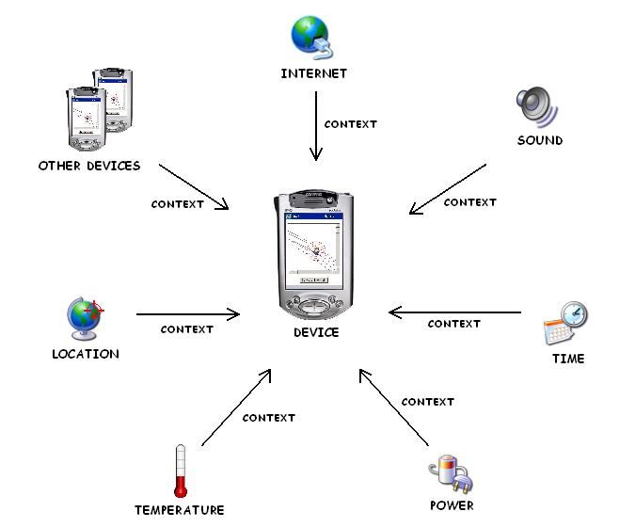
Context Aware Computing Application

Slide 6
Examples of Applications
Reminder applications
Advertisement applications
Medical applications
Security applications
Parking place applications
Redirecting applications
Taxicab applications
Proximity applications

Slide 7
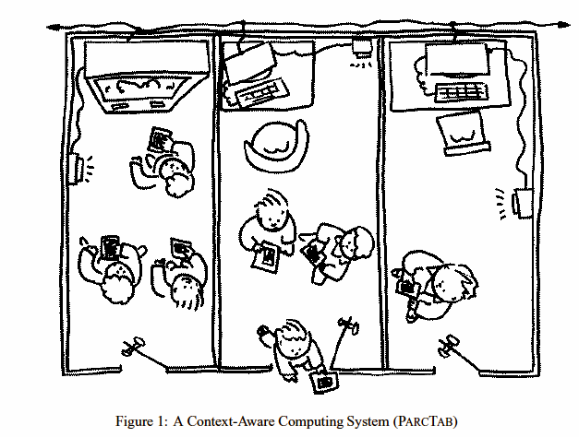
PARCTAB: a wireless, palm sized computer

Slide 8
Four categories of context-aware applications
 | Manual | Automatic
information | information proximate selection & contextual information | automatic contextual reconfiguration
command | contextual commands | context-triggered actions

Slide 9
Proximate Selection
Proximate Selection is a user interface technique where the located-objects that are nearby are emphasized or otherwise made easier to choose.

Slide 10
Three kinds of objects interested in using this technique
Computer input and output devices that require co-location for use
Set of objects that you are already interacting with which need to be addressed by a software process.
Set of places one wants to find about.

Slide 11
Instance of Proximate selection with PARCTAB
Proximate selection may also be used to choose virtual objects.
Using the PARCTAB voting application, users select previously created ballots either alphabetically or by the current location. This use of proximate selection is helpful when ballots are referenced at particular locations – e.g., voting on what snacks to have at High Tea – or when you are meeting with a group that has just created a ballot.

Slide 12
Challenges of Proximate Selection
User interfaces for proximate selection pose some challenges. For example, how can a UI display both alphabetical and proximity information simultaneously.

Slide 13
Automatic Contextual Reconfiguration
Reconfiguration is the process of adding new components, removing existing components or altering the connections between components.

Slide 14
Instance of Reconfiguration with PARCTAB
Consider a multi user drawing program for the PARCTAB which provides a workspace for each room like a sort of virtual white board.
On entering the room causes an automatic binding between the mobile host and the room’s white board.
In this way people in the same room can easily collaborate using the virtual whiteboard.
Automatic Reconfiguration creates illusion of accessing the virtual object as if it were physical.

Slide 15
Challenges of Automatic Contextual Reconfiguration
Problems faced by reconfigurable systems include if the context is changing rapidly it may be distracting to the user or impractical to adapt to every change.
Also, certain adaption's may confuse users, particularly if the context is incorrectly reported, if the user is unaware of what context an application considers relevant, or if the context changes during use.

Slide 16
Contextual Information and Commands
People’s actions can often be predicated by their situation. Contextual information and commands exploit this fact.

Slide 17
Instance of Contextual Information and Commands with PARCTAB
Location browser is a PARCTAB application that views a “location-based file system”.
Directories are named after locations and contain files, programs and links. When moving from room to room, the browser changes the displayed directory to match the viewers’ location.
For example when in office we see the occupant’s finger plan and calendar files.

Slide 18
Challenges of Contextual Information and Commands
Businesses and government agencies would find it profitable to export contextual information and commands in order to inexpensively engage large numbers of potential customers. However, people interacting with third parties need to ensure security and authenticity of the information. Also, personal customizations must somehow coordinate with those provided by third parties.

Slide 19
Context Triggered actions
Context-triggered actions are simple IF-THEN rules used to specify how context-aware systems should adapt.

Slide 20
Applications of Context-Triggered Actions
Two context-triggered action applications, Active Badge based “Watchdog” and tab based “Contextual Reminders.”

Slide 21
Watchdog Program
The watchdog program monitors Active Badge activity and executes arbitrary Unix shell commands.
On startup the program reads a user’s configuration file containing a description of Active Badge events and actions.
badge location event-type action
For example : Coffee Kitchen arriving "play -v 50 ˜/sounds/rooster.au“
In this case it monitors the “coffee” badge which is attached to the coffee maker in the kitchen and plays the rooster sound whenever anyone makes coffee.

Slide 22
Contextual Remainders
Contextual Reminders permit a fuller description of the situation for when a reminder should occur. A message pops up according to when, where, who and what is with you.
For example, the “next time in the library” or the “next time I see Marvin,” or “when I’m back at my desk.”
The PARCTAB implementation of Contextual Reminders pops up a message on the tab when different situations occur.

Slide 23
Challenges of Context-Triggered Actions
How to balance the requirement of timely execution with the need for predictable behavior
The other two problems to be addressed are the expressiveness of the predicate language, and the accuracy and timeliness of the underlying context information.

Slide 24
Challenges faced by Context-Aware Applications
How to represent context internally?
– Storage
– Data structures and algorithms
How frequently does the system need to be updated on context changes?
– How often to poll?
– How often to change behavior?
What sensors, infrastructure, or sensors are necessary?
– What is the fallback condition?
How to sense location information?
– Technical details
– History of location?

Slide 25
Readings and References
Context-Aware Computing Applications Bill N. Schilit, Norman Adams, and Roy Want
Challenges in implementing Context Aware systems, Satya

Slide 26
Questions???

Slide 27
THANK YOU!!!

